Slide 1
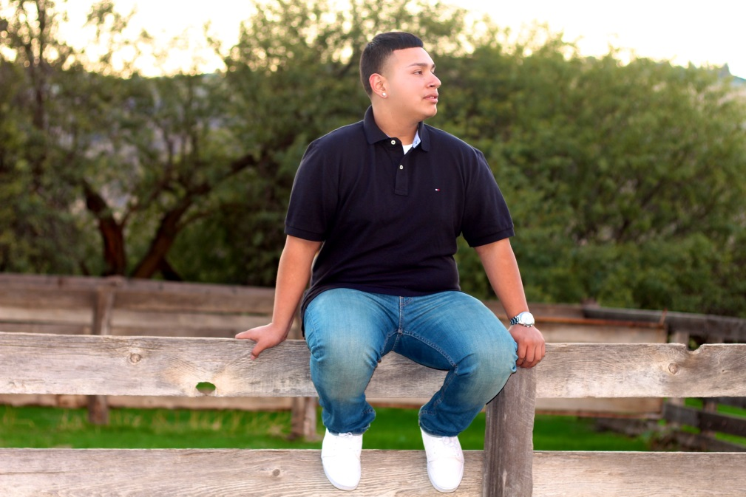
Jorge Vega

Slide 2
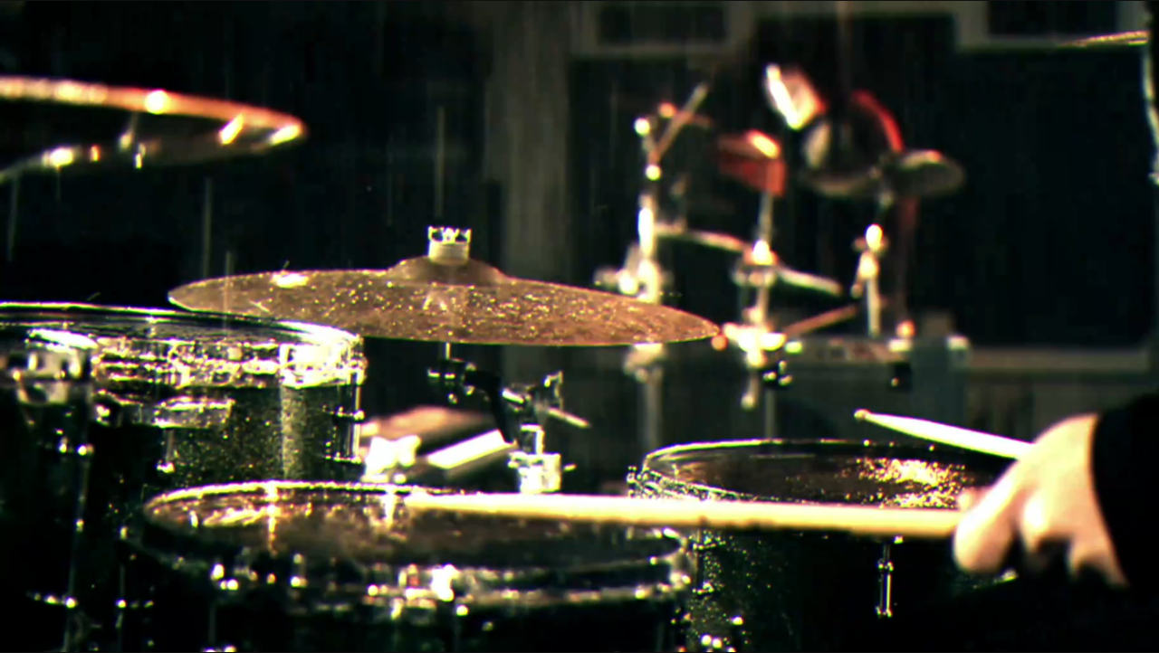
About Me
Oldest of two
Enjoy creating video’s and playing the drums
Some personal challenges are being on pace and learn how to play the drums

Slide 3
High School Experience
Mulitmedia & Video Editiong
In the PBS system we work on our level
Personal challenge Great Grandma died
Hard worker, Procrastinator
How high school has readied by showing me how a hard worker I am

Slide 4
Job Shadow
Supervisor
Fabian Lemus
Nichols Farms
It intrests me because I like making sure stuff get done right.
If there is workers working night shifts you have to go check up on them
Showing me how you spray chemicals on trees
I enjoy working outside

Slide 5
Pathway
Technology
Video Editing
Multimedia
Music tech
Web-deign
Really intrests me , great technology
If you really want it strive for sucsses

Slide 6
Post-High School Plans
Career
This works for me because I want to work a couple of months before i apply to COS or PC and take my general ed classes
I have my family’s and friends support
My goal is to make my family proud

Slide 7
Leaving LHS
Prepared me for the real world
It has shaped me into a hard working student
Having great teacher that are willing to help
PBS has taught me that working hard gets you where you want to be
Completeing work on time

Slide 8
Questions ??

